Slide 1
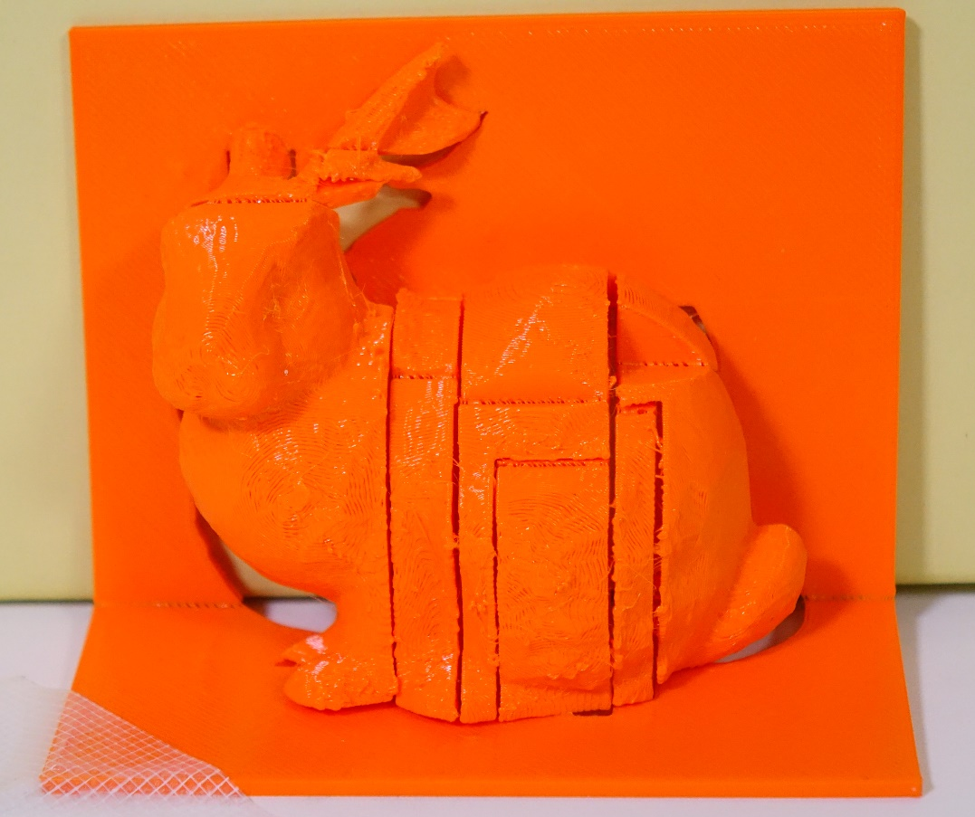
Fabricatable 90˚ Pop-ups: Interactive Transformation of a 3D Model into a Pop-up Structure
Junpei Fujikawa, Takashi Ijiri
Shibaura Institute of Technology
Notes:
In this work, we are going to present a method to create pop-up structures with a 3D printer.

Slide 2
Introduction
Fabricatable 90˚ pop-ups
Interactive Modeling
Automatic Transformation
Results
Notes:
We would like to begin with introduction.

Slide 3
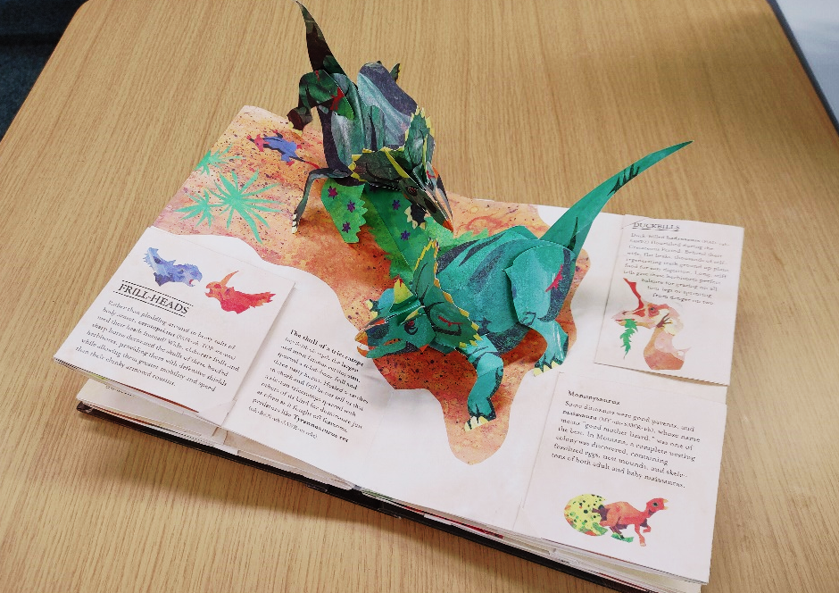
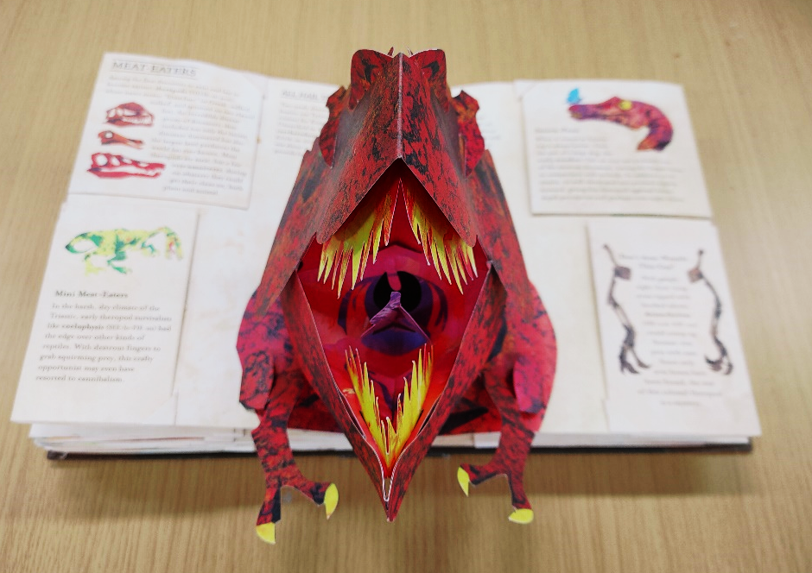
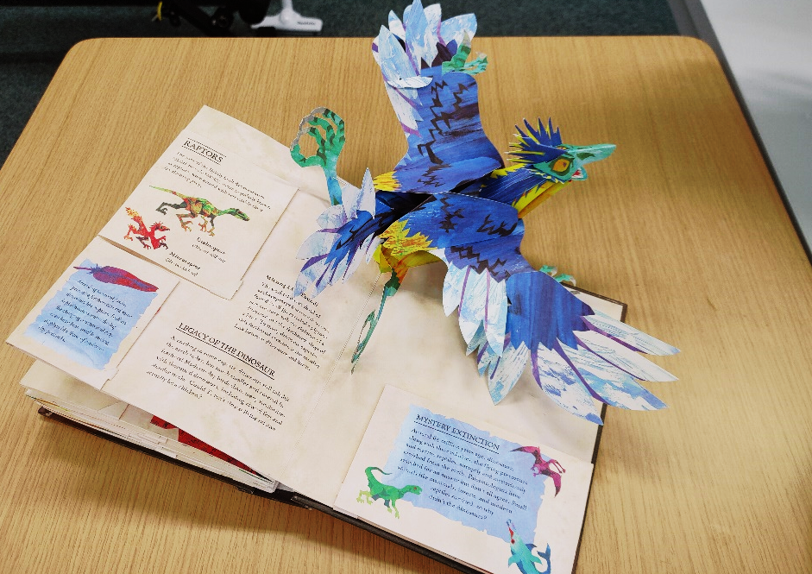
Background: Pop-ups
Pop-ups are a kind of papercraft used for birthday cards and books
3D shapes appear when unfolding cards or books
[Sabuda and Reinhart. 2005]
Notes:
Pop-ups are a kind of papercraft.
They are enjoyed as birthday cards and pop-up books like these.
In the pop-ups, 3D shapes appear when unfolding cards or books.

Slide 4
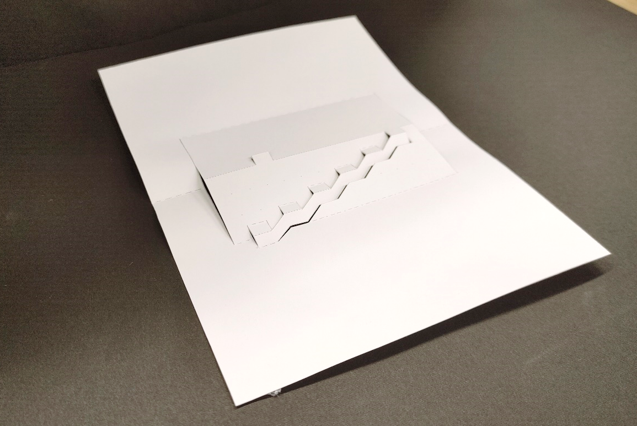
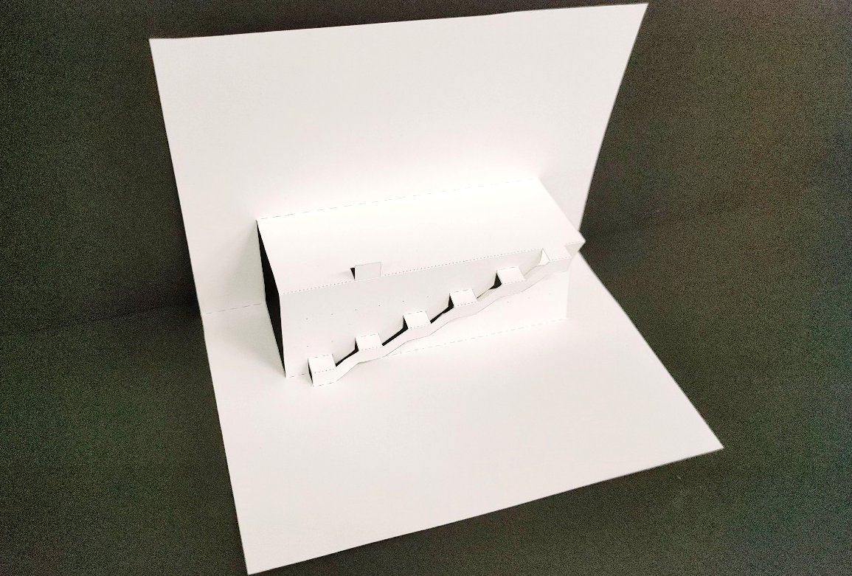
Background: 90˚ pop-ups
90˚ pop-ups are a kind of the pop-ups
Created by cutting and creasing a single sheet of paper
3D shape appears when folding the base paper 90˚
[Chatani. 1986]
Notes:
In this work, we focus on 90-degree pop-ups.
They are a kind of the pop-ups.
This type of pop-up can be created by cutting and creasing a single sheet of paper.
A 3D shape appears when folding the base paper 90°.

Slide 5
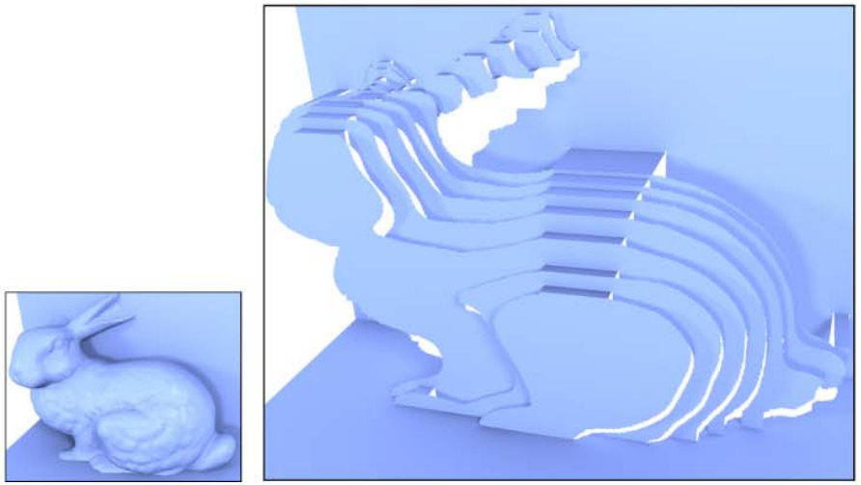
Computational 90˚ pop-ups
[Mitani and Suzuki 2004]
Tool for interactively modeling 90˚ pop-ups
[Li et al 2010]
Convert a 3D model into 90˚ pop-up using a voxelization technique
[Le et al 2014]
Vertically slice a 3D model to obtain a pop-up structure
Notes:
90° pop-ups have been important topic in computer graphics.
Various methods have been developed for modeling them.
●Mitani and Suzuki presented a tool for interactively modeling 90° pop-ups in 3D space.
●Li et al. proposed an algorithm for automatically converting 3D models into 90° pop-ups using a voxelization technique.
●Le et al. also introduced an algorithm for automatically converting 3D model into 90 pop-ups.
They vertically slice a 3D model to obtain a pop-up structure.

Slide 6
Computational 90˚ pop-ups
Difficult to create pop-ups with curved surfaces
because the previous methods use flat paper
[Mitani and Suzuki 2004]
Tool for interactively modeling 90˚ pop-ups
[Li et al 2010]
Convert a 3D model into 90˚ pop-up using a voxelization technique
[Le et al 2014]
Vertically slice a 3D model to obtain a pop-up structure
Notes:
However, It is difficult to create pop-ups with curved surfaces
because the previous methods use flat sheet of paper.

Slide 7
Represent Various 3D models with 90° pop-ups Propose fabricatable 90° pop-ups that can be fabricated using 3D printers
Goal:
Approach:
Step1: Design a layout of pop-up components
Step 2: Convert the planer pop-up into 3D fabricatable form
Step 3: Fabricate the 90˚ pop-ups using a 3D printer
Notes:
The goal of this work is to represent various 3D models using the 90° pop-ups.
We propose 'fabricatable 90° pop-ups,' that can be fabricated using 3D printers.
The process to create fabricatable 90° pop-ups involves the following steps:
First, The user interactively designs a layout of pop-up components that roughly approximates the input 3D model.
Second, the system converts the planer pop-up into 3D fabricatable form.
Finally, we fabricate the 90° pop-ups using a 3D printer.

Slide 8
Introduction
Fabricatable 90˚ pop-ups
Interactive Modeling
Automatic Transformation
Results
Notes:
Next, we are going to introduce the detailed definition of our fabricatable 90˚ pop-ups.

Slide 9
Traditional 90° pop-ups
Made by single sheet
One concave fold exist
base patch
base fold
fold angle
Notes:
First of all, we would like to explain the structure of the traditional 90 pop-ups made by paper.
The traditional 90° pop-ups is made by single sheet of paper .
There is one concave fold at the middle of the paper.
These two patches are called as base patch and this fold is as the base fold.
The angle of this fold is called as fold angle.

Slide 10
Traditional 90° pop-ups
Made by single sheet
One concave fold exist
One can place a component on an existing concave fold
A component consists of two patch connected with a convex fold
convex fold
concave fold
Notes:
In our representation,
it is possible to place a pop-up component on an existing concave fold.
This component consists of two rectangular patches.
Now, we have two new concave folds and one convex fold.
It is also possible to place new component onto these concave folds.

Slide 11
Traditional 90° pop-ups
Made by single sheet
One concave fold exist
One can place a component on an existing concave fold
A component consists of two patch connected with a convex fold
One can place multiple component to model various 3D structures
Notes:
It is possible to place multiple components hierarchically to generate various 3d structures.
The hierarchical layout can be represented with a tree data structure

Slide 12
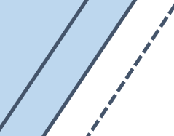
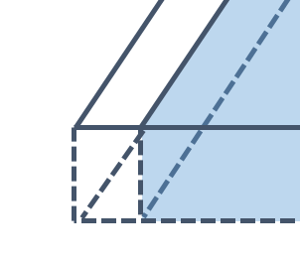
Fabricatable 90° pop-ups
We extend the traditional 90˚ pop-ups fabricatable
$$T$$
Add thickness $T$ to each patch
Add gap $g$ between patches to maintained margin
$$g$$
Notes:
We extend the traditional 90 pop ups made by paper into fabricatable form.
These are illustrations of a fabricatable pop up.
First of all, we add thickness to each patch so as to ensure that each patch is rigid enough.
We also add gap between disconnected patches so that the margin is maintained during printing.

Slide 13
Fabricatable 90° pop-ups
$$g_{f}$$
We extend the traditional 90˚ pop-ups fabricatable
Add thickness $T$ to each patch
Add gap $g$ between patches to maintained margin
Connect patches with thin surface at fold
$$T_{f}$$
concave fold
$$g_{f}$$
45°
45°
$$T_{f}$$
Apply 45˚ bevel at the convex fold
Notes:
At each fold,
we add gap between patches and connect patches with thin surface.
●The concave fold is highlighted with red color.
This is an illustration of the concave fold.
The neighboring patches are connected by thin surface with small gap gf.
●The convex fold is highlighted with light blue color.
This is also an illustration of the convex fold.
The convex fold is folded into this orientation (CLICK) we apply 45-degree bevel as this.

Slide 14
Benefits: Fabricatable 90˚ pop-ups
✔ Using flexible material (TPU), the fold works without complicated structure
✔ The pop-ups contain the necessary cuts & folds, no assembly process is required
✔ It is possible to modify the shape of each patch to represent various curved shapes
Notes:
There are multiple benefits of our fabricatable 90 pop-ups.
By fabricating this 90 pop ups with a flexible material such as TPU, the fold works well without complicated structure such as hinges.
The pop-up structure already contains the necessary cuts and folds, no additional assembly process is required.
Also, since we use a 3D printer, It is possible to modify the patch shape to represent various curved shapes.
We will discuss this modification later.

Slide 15
Introduction
Fabricatable 90˚ pop-ups
Interactive Modeling
Automatic Transformation
Results
Notes:
Next, we are going to talk about the interactive modeling process, demonstrating our system.

Slide 16
Demo
Notes:
(I deleted application video because video data size is very large. Please check online video. https://www.youtube.com/watch?v=cjLScXbYkLw)
This is our prototype modeling system.
At the beginning, the user loads a reference 3D model.
Now, I loaded a Stanford bunny model.
The user model pop-up structure that approximate this model.
To place a pop-up component, the user switch the placement mode, and clicks an existing fold.
Then the system place a new component at the fold, like this.
To deform components, the user switch to the deformation mode and clicks a target component.
The deformation handle appears, and it is possible to modify the height and width using this handle.
During modeling, the reference model visualization can be turned on and off by pressing the shift key.
The user repeats this process to design the layout of pop-up components.
The motion of all the pop-up components can be simulated by dragging the slider below the main window.
After designing the pop-up structure, the user presses this transformation button.
The system automatically transforms all components to approximate the reference model.
After few minutes, the system outputs a fabricatable ninety-degree pop-up.
The user can simulate its motion.
This model can be fabricated with a 3D printer.
So, I will go back to the slide…

Slide 17
Introduction
Fabricatable 90˚ pop-ups
Interactive Modeling
Automatic Transformation
Results
Notes:
We will explain the method to transform a planer pop-up into fabricatable form.

Slide 18
Transformation pipeline
Input: Pop-up & model
Adding thickness
Trimming outlines
Transforming patches
Fabricating
pop-up
Notes:
The transformation consists of four steps.
The input is the user-designed planner pop-up and the 3D model.

Slide 19
Transformation pipeline
Input: Pop-up & model
Adding thickness
Trimming outlines
Transforming patches
Fabricating
pop-up
Notes:
First, we add thickness to all patches.

Slide 20
Add thickness
In the unfolded state…
Thicken each patch in height orientation
Add gap between disconnected component
Connect patches at folds
Notes:
We consider the unfolded state of the user designed flat pop-up.
● We thicken each patch in height orientation.
● We add gap between disconnected component.
● We connect patches at folds.

Slide 21
Transformation pipeline
Input: Pop-up & model
Adding thickness
Trimming outlines
Transforming patches
Fabricating
pop-up
Notes:
Next, we modify the outline shape of pop-up components by trimming their outlines.

Slide 22
Trimming outlines
In the 90˚ folded state…
Notes:
For trimming outline, we consider the 90° folded state of thickened pop up.
We overlay the target 3D model.

Slide 23
Trimming outlines
$$∩$$
In the 90˚ folded state…
Compute intersection (CSG) between each patch and 3D model
* In unfolded state, empty space is created around the outline
Notes:
We compute the CSG intersection between each patch and the target 3D model, to modify the shape of pop-up component.
This is the unfolded state of this model.
By this CSG operation, as you can see here, empty spaces is created outside the outlines (POINTING).

Slide 24
Trimming outlines
In the 90˚ folded state…
Compute intersection (CSG) between each patch and 3D model
Fill the empty space by adjusting the patch inward
Notes:
We fill this gap by adjusting the patches inward.

Slide 25
Transformation pipeline
Input: Pop-up & model
Adding thickness
Trimming outlines
Transforming patches
Fabricating
pop-up
Notes:
Next, we transform all patches having 3D shape to better approximate the model.

Slide 26
Transform patch: Observation
It is possible to deform each patch within the region above
✔ Better approximation of the target model by adding 3D shape
If we deform patches freely, intersection may occur when folding
→ We compute the deformable region for each patch to avoid such intersection
Notes:
There is an important observation.
It is possible to deform each patch within the region above, because we fabricate pop-ups with 3D printer.
We can deform each patch within region above (like this).
This is the 2D illustration slicing the pop-up in this red plane and this is a folded structure.
We can achieve better approximation of various models by deforming patches (like this).
Notice that although this is bad example,
If we deform patches freely, intersection may occur when folding the-unfolded-pop-up as in this example.
We then compute deformable region for each patch to avoid such intersection

Slide 27
Transform patch: Compute deformable region
Compute a region in which a patch is deformable without intersection
Focus on a patch C
Sweep the patch in its normal direction
Identify all components that might potentially intersect with the patch C
Sweep two patches of each identified components and compute their bounding box
Subtract the bounding box from the swept region of the patch C
→ Deformable region of C
C
Notes:
For each patch, we compute a region in which the patch is deformable without intersection.
We explain this process by using this example (POINT the RIGHT).
Let us focus on this patch C.
We sweep this patch in its normal orientation.
We identify all components that might potentially intersect with the patch C.
If we deform this patch in this green region, the deformed patch will intersect with this red component.
We sweep patches of the identified component.
In this case we sweep two patches of this red component.
(CLICK) We also compute the bounding box of the swept regions.
(CLICK) Finally, we subtract the bonding box from the swept region of the patch C to obtain the deformable region.

Slide 28
Transform patch: Compute deformable region
Computation of the deformable region is formulated using CSG operation...
→ See paper for detail
$$V\left(C_{i}\right)=S_{i}^{+y}⊖\sum_{j∈N_{i}^{y}}{(B_{j}^{+}⋃B_{j}^{−})}$$
$$H\left(C_{i}\right)=S_{i}^{+x}⊖\sum_{j∈N_{i}^{x}}{(S_{j}^{+x}⋃B_{j}^{−})}$$
Notes:
In general, the computation of the deformable region can be formulated by using the following CSG operation.
Please see the paper for more detail.

Slide 29
Transform patch
We obtain deformable region for each patch
We deform a patch by using CSG intersection of the deformable regions and the input model
CSG intersection
Notes:
We obtain deformable region for each patch
We deform each patch by using CSG intersection between the deformable regions and the input model.

Slide 30
Transformation pipeline
Input: Pop-up & model
Adding thickness
Trimming outlines
Transforming patches
Fabricating
pop-up
Notes:
After transformation steps,

Slide 31
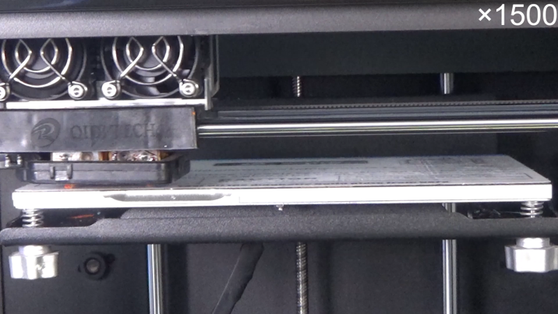
Fabricate pop-up
We fabricate a generated pop-up in the unfolded state using a 3D printer
The fabricatable 90˚ pop-up works without additionally assembly process
x15000
Notes:
(I deleted application video because video data size is very large. Please check online video. https://www.youtube.com/watch?v=cjLScXbYkLw)
We fabricate a generated pop-up in the unfolded state using a 3D printer.
The fabricated pop-up works well without additionally assembly process.

Slide 32
Introduction
Fabricatable 90˚ pop-ups
Interactive Modeling
Automatic Transformation
Results
Notes:
Finally, we show our modeling results.

Slide 33
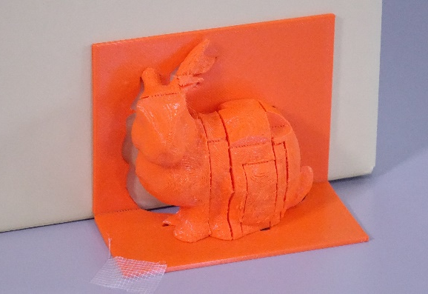
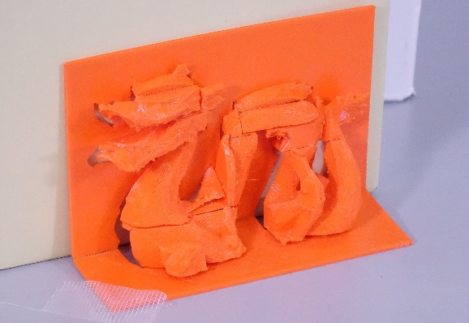
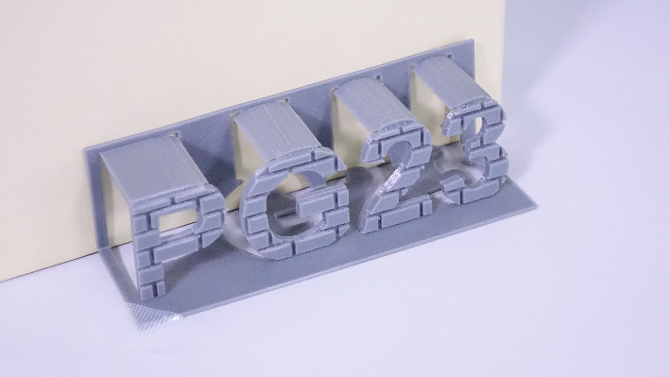
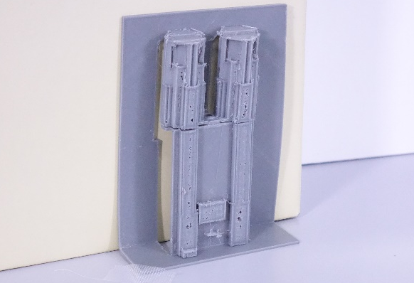
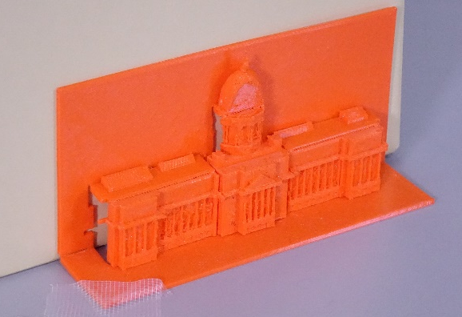
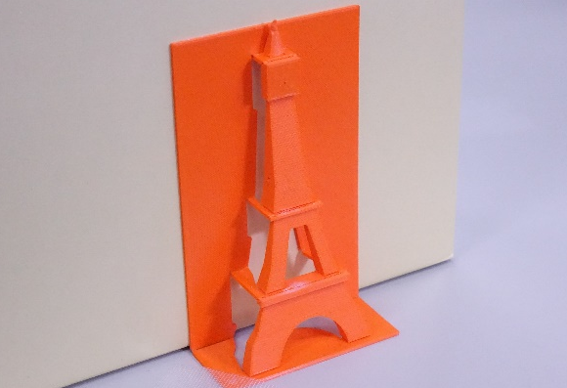
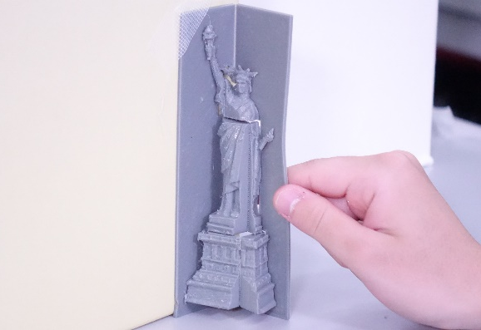
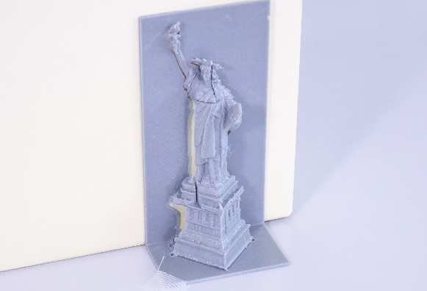
Various fabricatable 90˚ pop-ups (1/4)
[A part of “3D City Model (by Project PLATEAU) 23 Wards
of Tokyo” by “Urban Policy Division, Urban Bureau, MLIT”,
http://www.mlit.go.jp/plateau/site-policy/]
[“Kentucky State Capitol” by “3dky”, CC BY 4.0]
[“Eiffel Tower” by “Madhumitha”, CC BY 4.0]
[“Statue of Liberty 3D Scan” by “GoMeasure3D”, CC BY 4.0]
[“Statue of Liberty 3D Scan” by “GoMeasure3D”, CC BY 4.0]
Designed by authors within 5–15 min
3D printer: QIDI X-pro
Materials: Orange: Overture TPU / Gray: e-SUN TPU
Notes:
To illustrate the feasibility of our method, we designed various fabricatable 90° pop ups.
These pop-up models were designed within from 5 to 15 minutes.
We fabricated them using a 3D printer QIDI X-pro and TPU materials, such as Overture TPU and e-SUN TPU.
This is one of the results, the bunny model.
I also have other results, so feel free to come after this talk if you are interested.

Slide 34
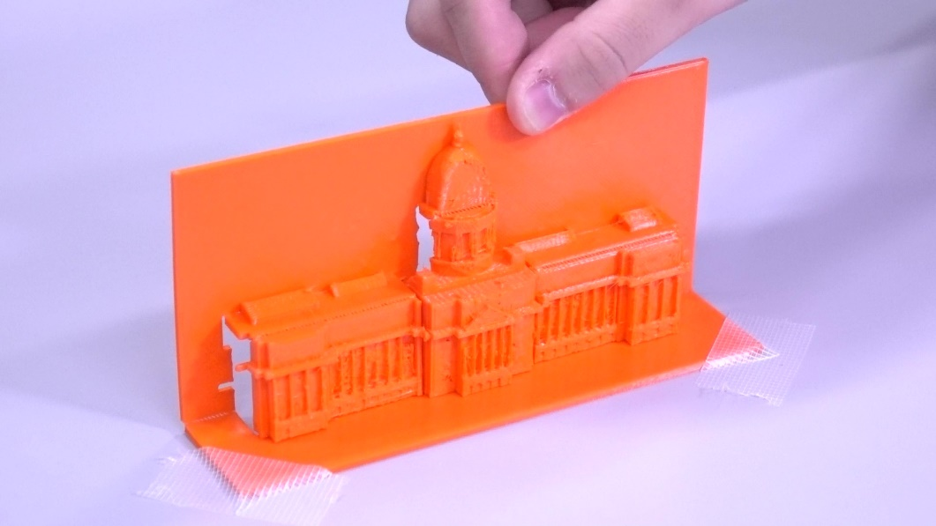
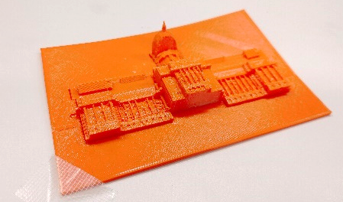
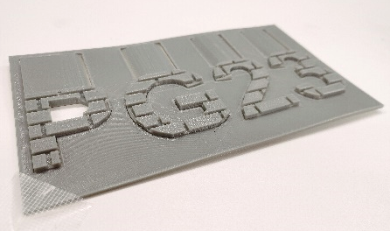
Various fabricatable 90˚ pop-ups (2/4)
Pop ups consists of simple component layout.
By adding various shapes to patches, we achieve to represent complicated 3D model
Notes:
These pop ups consists of very simple component layout.
By adding various shapes to patches, we could achieve to represent complicated 3D model.
For instance, This orange capitol model is composed of three components arranged in parallel to the base component.
Our method can represent this complex shape such a simple layout of pop-up.

Slide 35
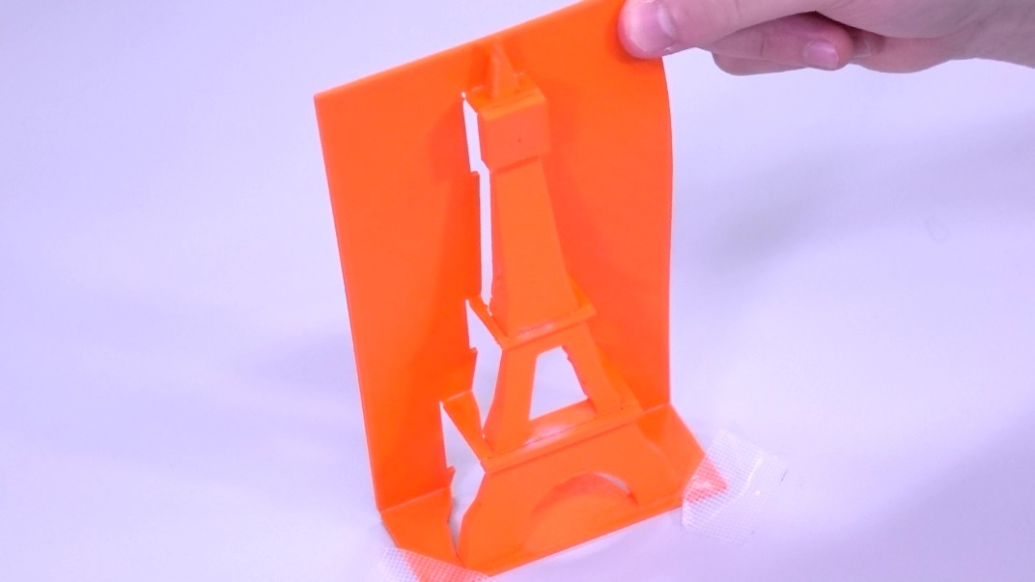
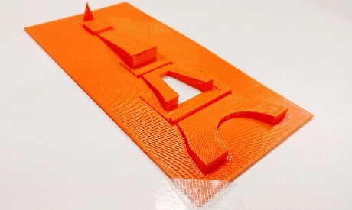
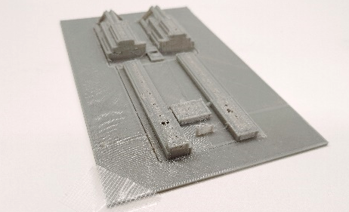
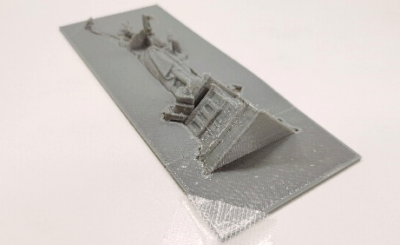
Various fabricatable 90˚ pop-ups (3/4)
Pop ups consists of hierarchical component layout.
We achieved to approximate various 3D models
Hierarchical layout allows reducing the height of pop-ups in unfolded state
Notes:
These pop ups are consisting of hierarchical layout.
In these examples, our method achieved to approximate various 3D models.
By applying hierarchical layout, we could reduce the height in unfolded state
In this example, the tower model is composed of three components arranged in hierarchical.
This hierarchical layout reduces the height in the unfolded state.

Slide 36
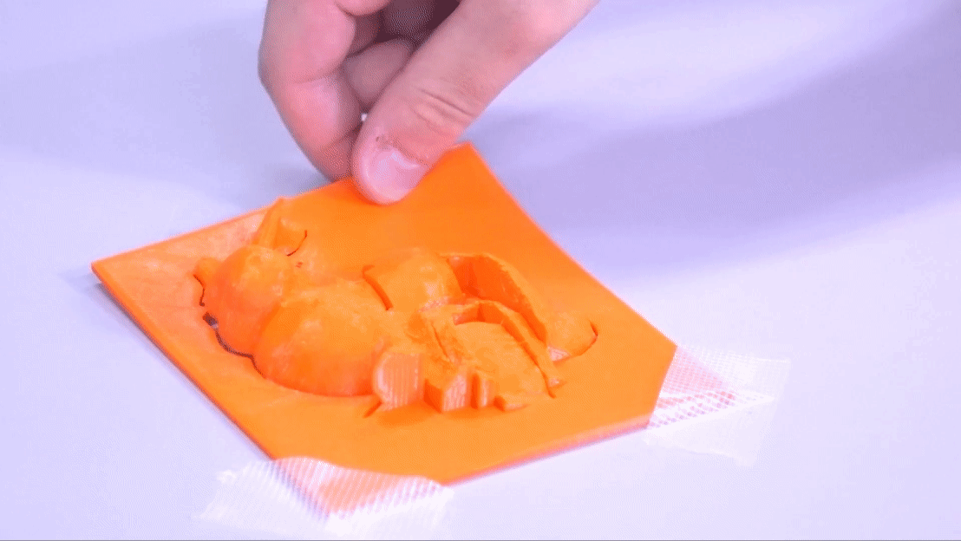
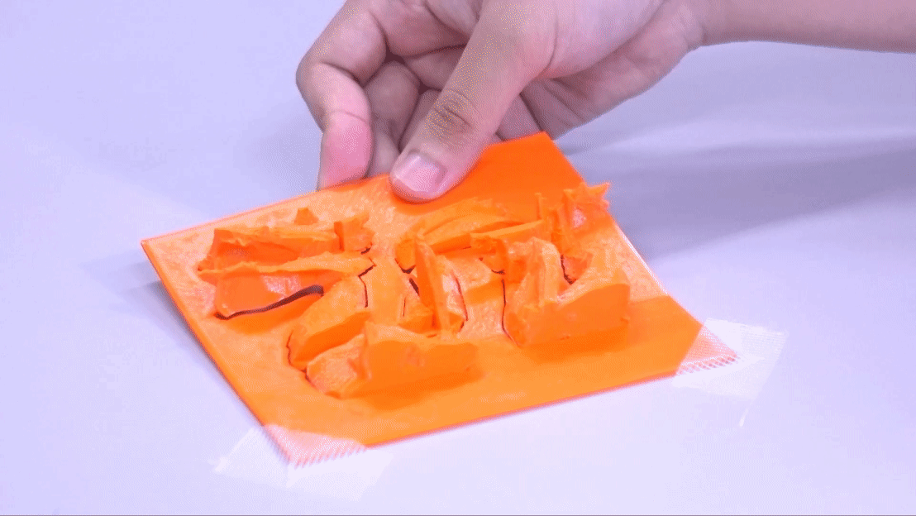
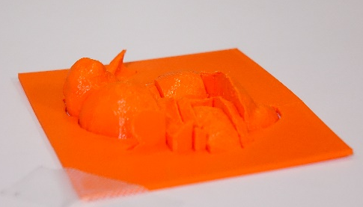
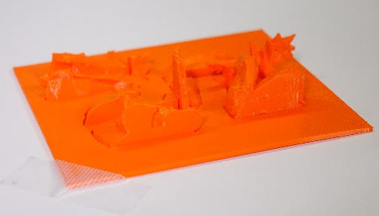
Various fabricatable 90˚ pop-ups (4/4)
More complicated, bunny and dragon, pop-ups
Bunny / dragon consist of 7 / 6 components
Notes:
This slide shows more complicated, Stanford bunny and Stanford dragon pop up models.
The bunny and dragon consist of SEVEN and SIX components, respectively.

Slide 37
Preliminarily user study
Three students participated
Task:
Learned the usage of our system
Created a tower model using reference images as a tutorial
Designed a fabricatable 90º pop-up with a building model
[“catan set vatican city design 1 v1” by “VLKB_Soven”, CC BY 4.0]
Notes:
To evaluate the usability of our method, we conducted a user study.
Three university students participated.
Each participant,
learned the usage of our system
created a tower model using reference images as a tutorial
and designed a fabricatable 90º pop-up with a building model
This is the 3D building model used in the study.

Slide 38
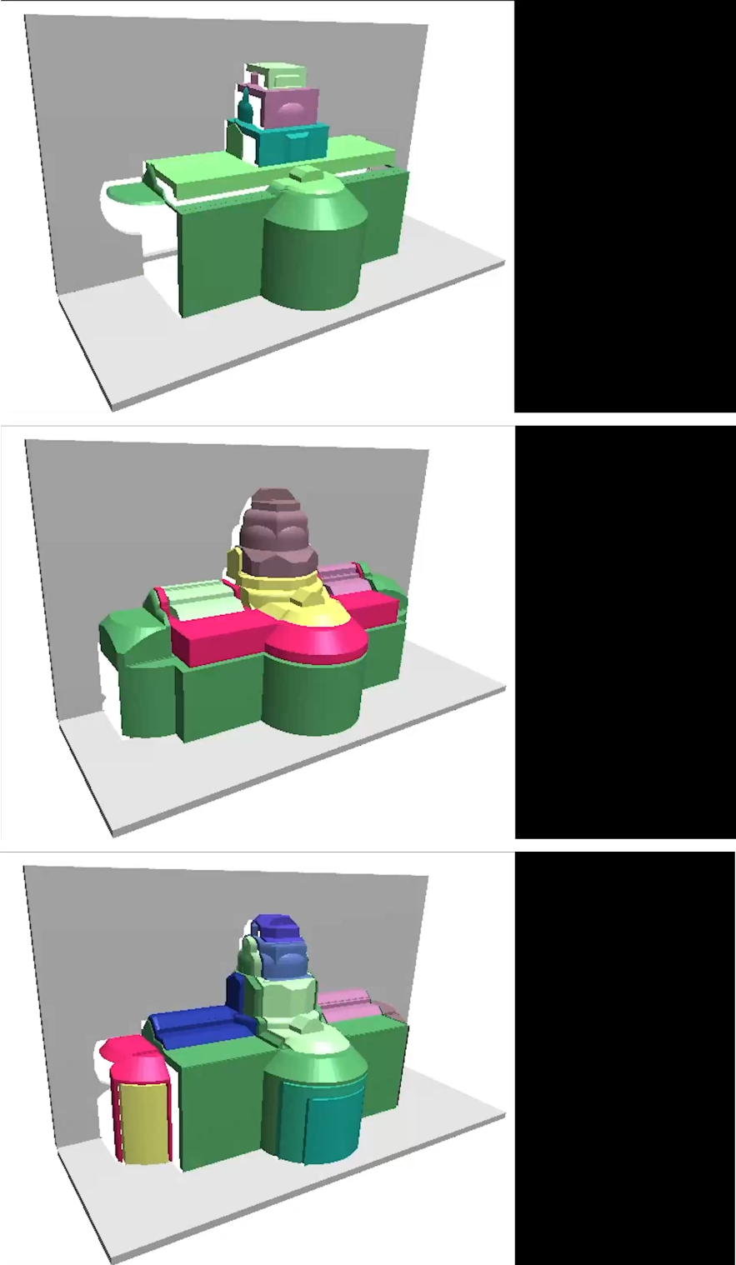
Preliminarily user study
User A
5 Components
17 min
Three students participated
Task:
Learned the usage of our system
Created a tower model using reference images as a tutorial
Designed a fabricatable 90º pop-up with a building model
User B
8 Components
38 min
User C
12 Components
20 min
[“catan set vatican city design 1 v1” by “VLKB_Soven”, CC BY 4.0]
Notes:
These are modeling results by participants.
While one participant UserB took for slightly longer time to fine-tune components,
all participants designed fabricatable pop-up within a reasonable timeframe.

Slide 39
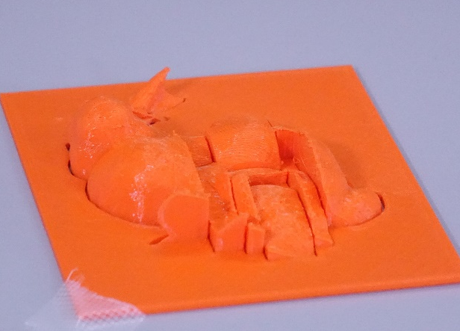
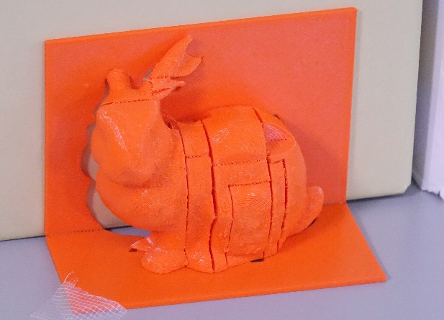
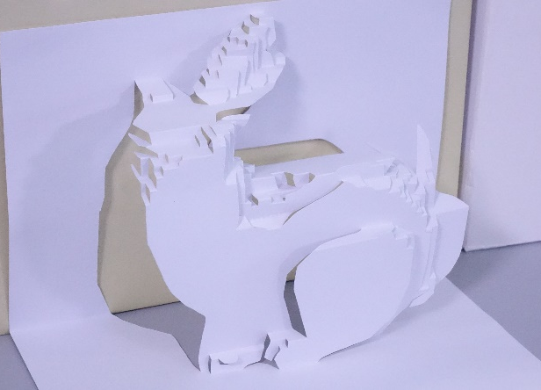
Comparison to previous paper-based popups
Fabricatable 90º pop-up (ours)
Paper-based pop-up [Li et al. 2010]
Advantage of our method
✔ Pop-ups with non-planar patches
✔ No assembly process
Notes:
This slide shows a comparison between
●the previous method for paper-based pop-ups presented by Li et al, and
●our farbicatable 90° pop ups.
One advantage of our method is that it is possible to create pop-ups with non-planar patches.
Please look at the bunny face.
Our method achieved better approximation with patches with curved shapes.
Another advantage is that
our method does not require assembly process.

Slide 40
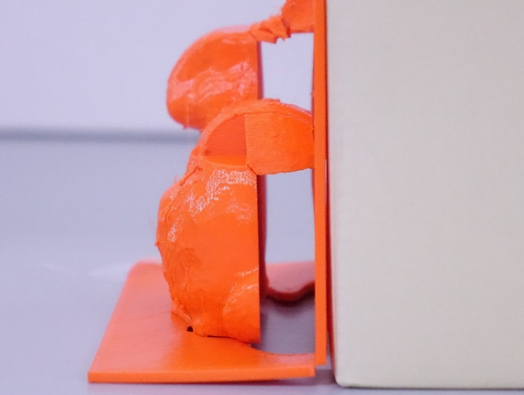
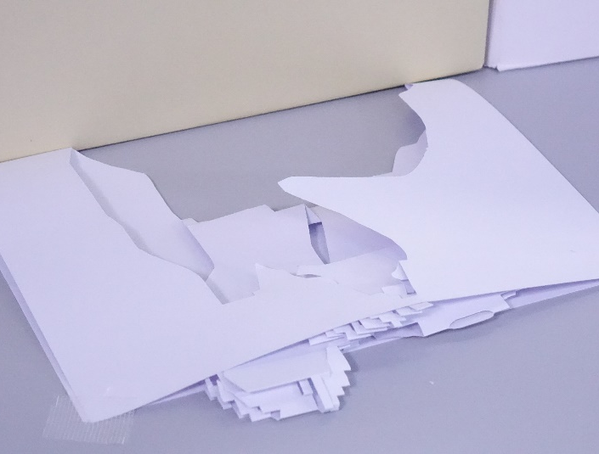
Comparison to previous paper-based popups
Fabricatable 90º pop-up (ours)
Paper-based pop-up [Li et al. 2010]
Advantage of our method
✔ Pop-ups with non-planar patches
✔ No assembly process
Disadvantage of our method
✘ Size is restricted by 3D printer
✘ Minimum fold angle is 90˚
Notes:
In contrast, one disadvantage of our method is that …
●The size of pop up is restricted by the 3D printer.
The printing volume size is usually not so big, it is difficult to create big pop up models.
● Another disadvantage is that
In our method, minimum fold angle is 90°.
It is difficult to fold the pop up completely like the paper pop up.

Slide 41
Limitations: Ignored region
Our method deform each patch in its deformable region
Parts of target model outside the region is not reconstructed
Notes:
One limitation of our method is the existence of ignored region.
Our method deform each patch in its deformable region to avoid intersection during folding and unfolding.
Then, parts of target model outside the region is not reconstructed.
For instance, these parts are not reconstructed as the pop-up model.
In future studies, we aim to develop new components to reduce this ignored region.

Slide 42
Conclusion
Present a method for designing fabricatable 90˚ pop-ups
Interactively design pop-up structure to approximate a target model
Automatically transform pop-up components into fabricatable form
Various modeling examples were presented
GitHub Page: https://github.com/InteractiveGraphicsLab/Fabricatable-90-Pop-up
GitHub Page
Notes:
To conclude the talk, this study presents a novel approach for designing and fabricating 90° pop-ups.
In our method, the user interactively design a pop-up structure by placing components to approximate the target 3D model.
Our method then automatically transform pop-up components into fabricatable form
To illustrate the feasibility of our method, we provided various modeling results.
The source code is available on our GitHub Page.

